Slide 1

{{ AngularJS Fundamentals Part 2 }}

Slide 2



{{ Arjay Elbore }}
Front-end Developer
@virtualoverride
https://github.com/ngvirtualoverride

Slide 3
{{ About Me }}
Front End Developer
Trainor/Speaker
1+ years on AngularJS
Node and .Net Technology

Slide 4
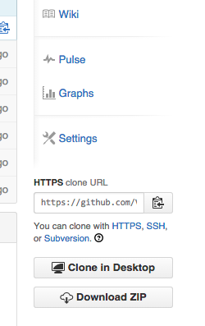
{{ Exercises and Demo App }}
git clone
https://github.com/ngvirtualoverride/ngDirectivesDemo.git
Or go to
https://github.com/ngvirtualoverride/ngDirectivesDemo
Click the download button

Slide 5

{{ Course Agenda }}
AngularJS Fundamentals Part 1 Review
Custom Directives
Demo

Slide 6
{{ Target Audience }}
Developers with experience using the following
HTML
CSS
Javacript

Slide 7

AngularJS Fundatamentals Review

Slide 8
{{ Custom Directives }}
Getting Started
Shared & Isolate Scope
The Link Functions
Using Controllers

Slide 9
{{ Getting Started }}
Roles of Directives
Creating Hello World

Slide 10
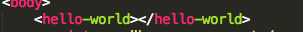
{{ Roles of Directives }}
Markers on a DOM element that tell AngularJS's HTML compiler ($compile) to attach a specified behavior to that DOM element.

Slide 11
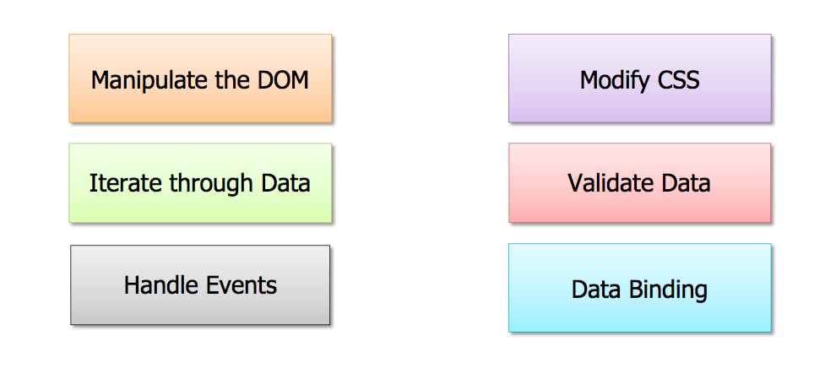
{{ What can Directives Do? }}

Slide 12
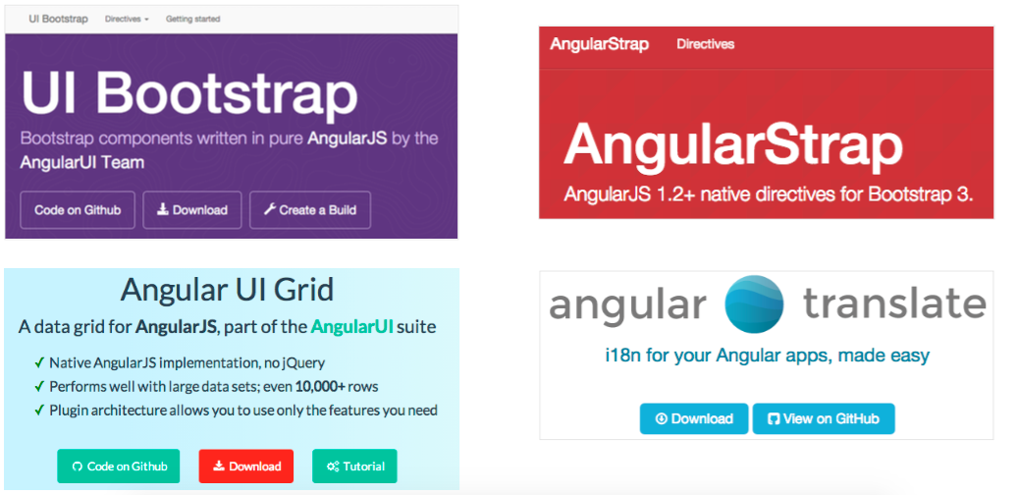
3rd Party Directives

Slide 13

What if there’s isn’t a directive that meets you need?

Slide 14


Slide 15
Creating HelloWorld Demo

Slide 16
Shared & Isolate Scope
@ Local Scope
= Local Scope
& Local Scope

Slide 17
The link function
DOM Driven Directives
All about DOM Manipulation
Behavior Driven Directives
All about handling DOM Events

Slide 18
link function Demo
HTML video pause and play
Adding attribute to element

Slide 19
Using Controllers
Data Driven Directive
All about data using other directives and controller

Slide 20
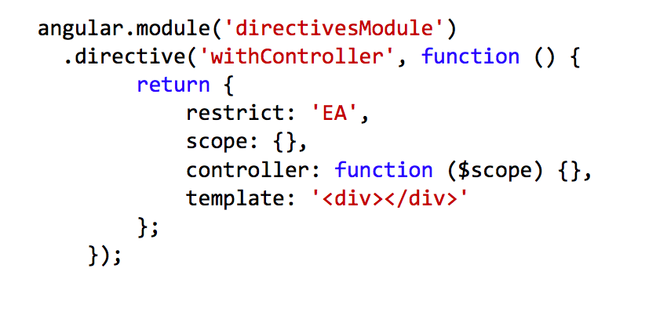
Adding controller property to DDO

Slide 21
Using Controller Demo
Hello World Demo

Slide 22
Mini Project
Template/Snippets
https://github.com/ngvirtualoverride/ngDirectivesDemoTemplate
bower install
bower install –g superstatic

Slide 23


Slide 24


